Slide 1
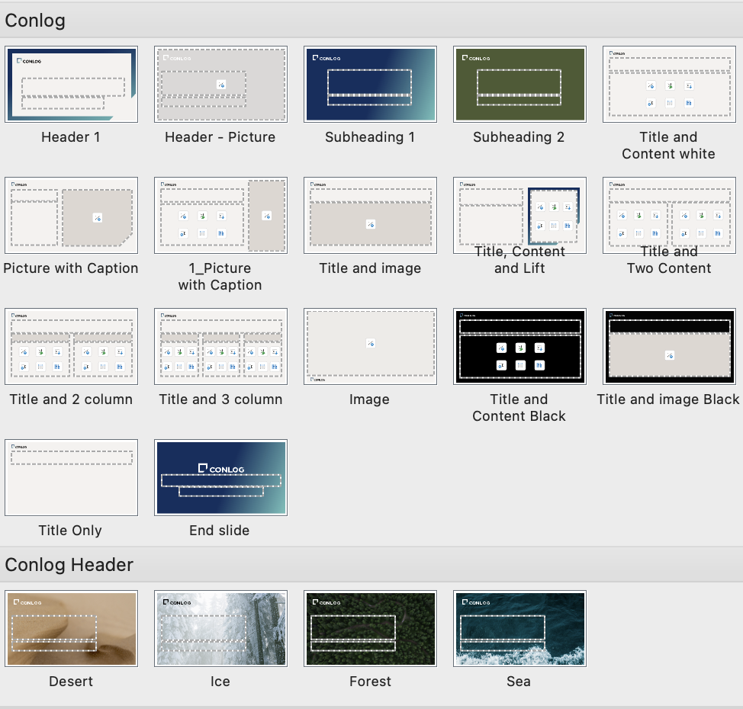
Master slides
Add a New Slide
Go to the "Home" tab and click "New Slide". From the dropdown menu, you can select a layout that suits your presentation needs.

